Slide 1
VIRTUAL TOURIST GUIDE
BY :- ROHAN SAXENA
MAHEEP

Slide 2
Why to Build ?
Replacement of Tourist Guides :-
Guides are often expensive and can also give false information.
Everywhere and every time tourist guides cannot be found.
Just a single click :-
By just clicking a single photo of the monument you can get all information on your mobile phone.
Will also suggest nearby places where you can visit.

Slide 3
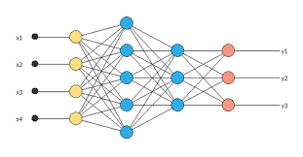

HOW MODEL IS BUILT ?
From Google API nearby places and information about monument is given to user.
INCREASING THE DATASET BY MANIPULATING IMAGES THROUGH LIBRARIES LIKE OPENCV, MATPLOTLIB AND NUMPY
Feeding the data into our Convolutional Neural Network
EXTRACTION OF DATA

Slide 4
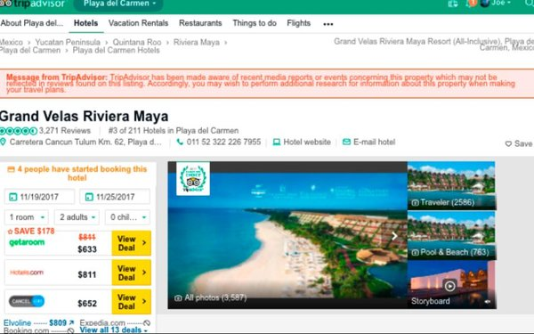
What to expect……
Opening the Webpage of following Monument on Tripadvisor.com
Taking 3 pictures of desired monument.
Process of Classification going in our Convolutional Neural Network.

Slide 5
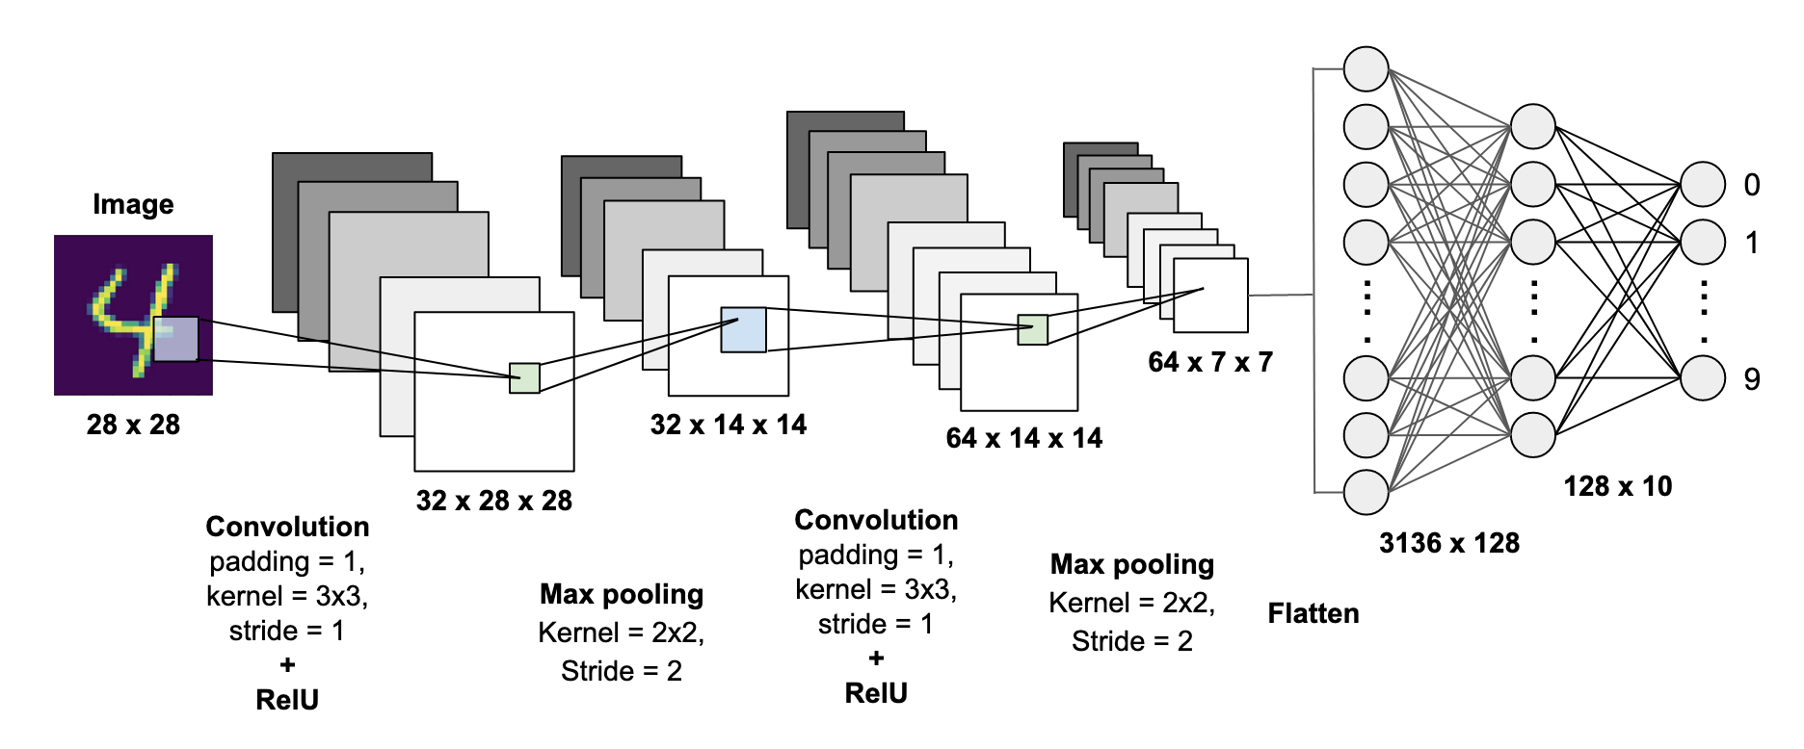
What is a Convolution Neural Network ?

Slide 6
Thank you.
By :- Rohan Saxena
Maheep

